Slide 1
L13-SNA Entity Resolution

Slide 2
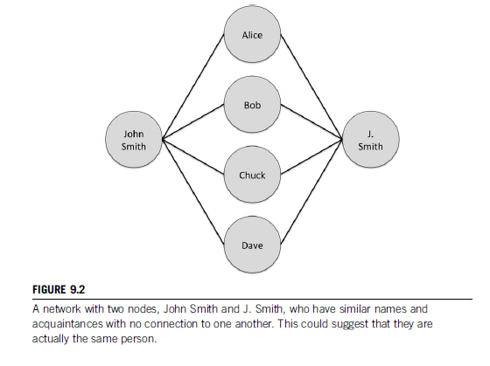
Entity resolution is a technique that tries to identify nodes that represent the same entity and then to merge them together.

Slide 3
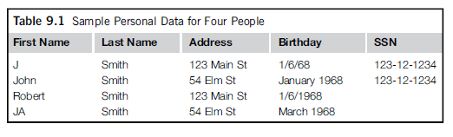

Slide 4
Wrt Node pairs A,J B,D E,I Calculate common neighbours, JI,AA, Preferential Attachment

Slide 5
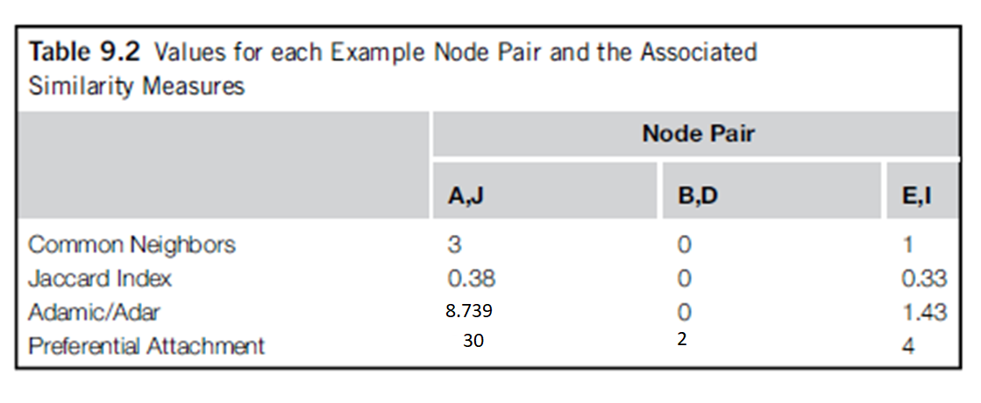

Slide 6
We have to compute scores by considering certain attributes
SSN/Aadhar, DOB, Address
Which attribute has higher weight and why?

Slide 7
Calculating weight using u and m probabilities
u- The u probability is that two nodes will match on an attribute by chance
Ex:DOB
Two persons with same DOB and same college are they same?
If month in the DOB matches then the probability that two persons have same month of DOB is 1/12, u probability for month in DOB is 1/12
How do you calculate the u probability for name ?
Example: Will Smith, Joe Smith etc (1% of Americans , 0.01)
Himmelbau (0.0000004)

Slide 8
The m probability is the probability that two nodes that represent the same person will have the same value
Ex: Two nodes that are same should have same Aadhar number and DOB
Setting the m probabilities will depend on the data you have

Slide 9
Once we know m and u , we have to calculate weights
We have two weights associated with an attribute
Add weights for a match
Subtract weights for a no match

Slide 10
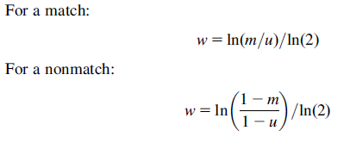
M = 0.98 for SSN say, u for DOB calculate the weights

Slide 11
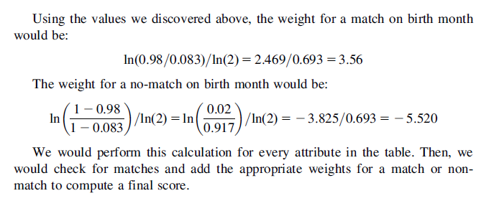

Slide 12

More sophisticated entity resolution

Slide 13
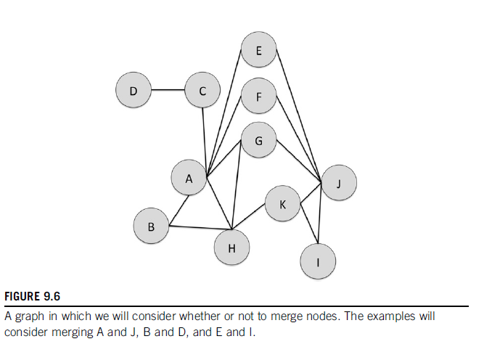

Slide 14
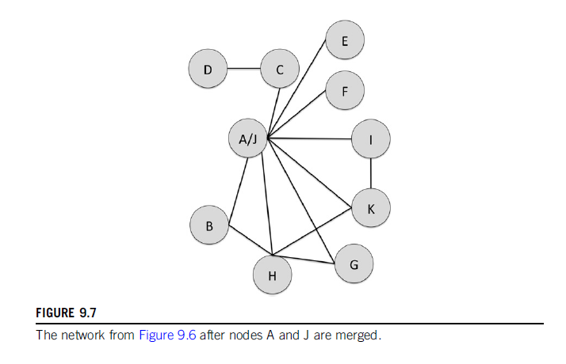

Slide 15
